Slide 1

Sophomore Solo Project
Engineering Principles
Macropad
Presented and built by:
Everett j. Pulskamp

Slide 2


The Problem
There are multiple inefficiencies related to keyboard shortcuts when using computer softwares that require the user to remember a lot of random keyboard strokes that are suppose to be simple. These activities include copy/paste, bold, extruding, revolved cuts, etc. The inefficiencies are the number of shortcuts and the combination of shortcuts that need to be used together. These are problematic because of the ability of the user to remember the complexity of the shortcuts.

Slide 3
The Solution
My solution is to make a small, programmable macropad that has multiple keys and rotary encoders to simplify using these keyboard shortcuts. For example, instead of a user needing to remember CTRL+SHIFT+T to reopen the last tab that they had open in their web browser, a single key can be pre programmed on the macropad so that the user only has to click one button instead of remember a combination of 3 different keys.

Slide 4
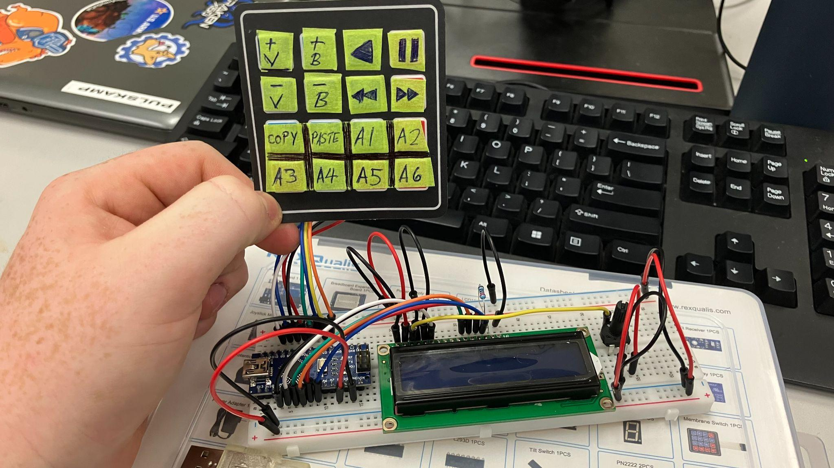
The Journey Concept Development
I started out by making a proof on concept with an Arduino UNO, 4x4 membrane keyboard, potentiometers, and an lcd display
The lcd display simulated the computer and would show what key was pressed and what the potentiometers changes
After a a few days with testing on the UNO, I switched to a Nano because it was smaller
The Arduino would not work because it didn’t have HID support so I chose a Raspberry PI Pico for the microcontroller

Slide 5
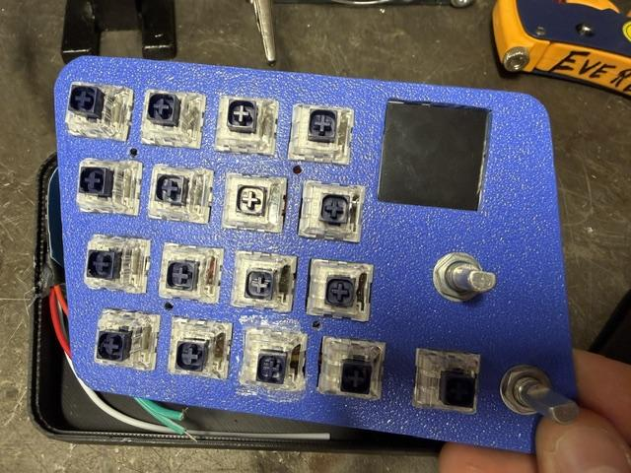
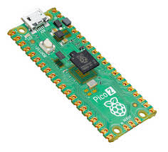
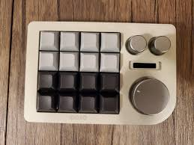
The Journey Design & Engineering
Design was heavily based on the Keebmonkey Megalodon for its use of mechanical keys and rotary encoders
Added screen display information related to what each key currently does, what the volume is etc.
Added RGB strip to back for a pop of color and customization
Made the size small enough to fit on any desk/working space
I did regularly have to redo the wiring so that it would stay clean and repairable
The key switches are connected to the Pico as rows and columns to minimize the amount of wiring needed

Slide 6

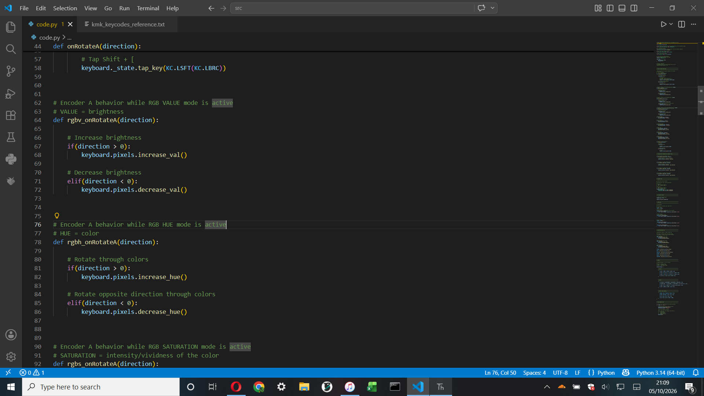
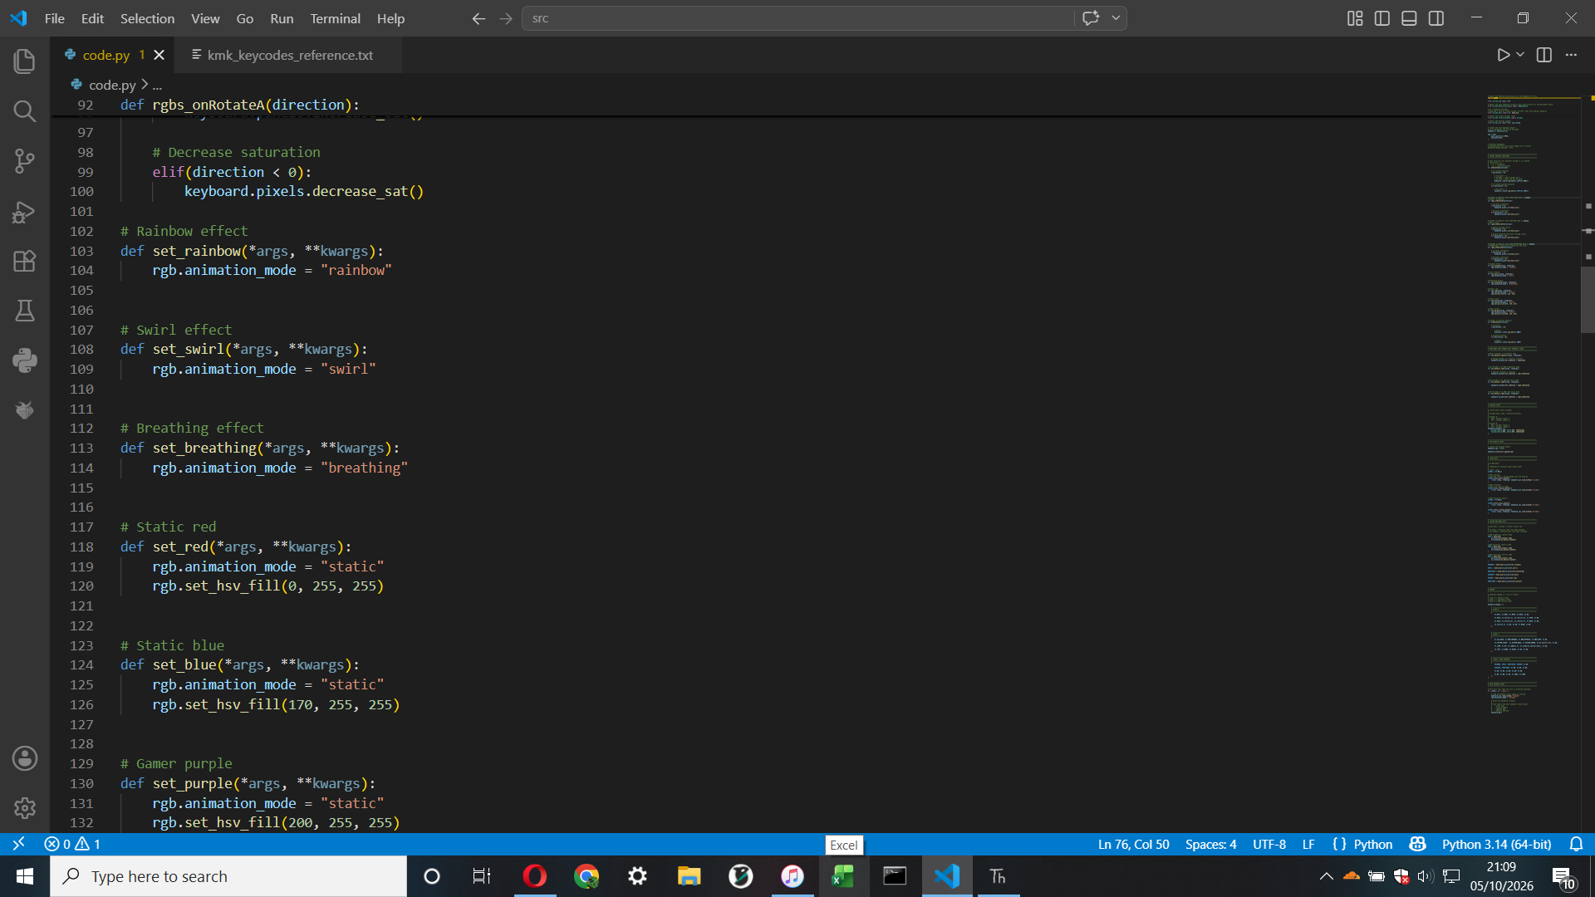
The Journey
Programming
Code is written in CircuitPython using VScode
Utilized KMK library
Had to go through 2 Raspberry PI Picos because the first one got fried while uploading programming
Uses “Layers” which are profiles that set what each key is programmed to do

Slide 7
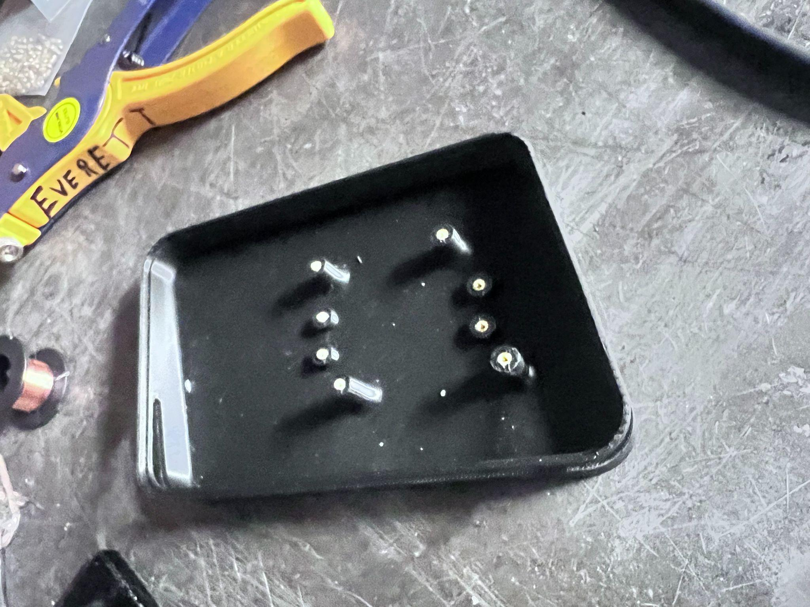
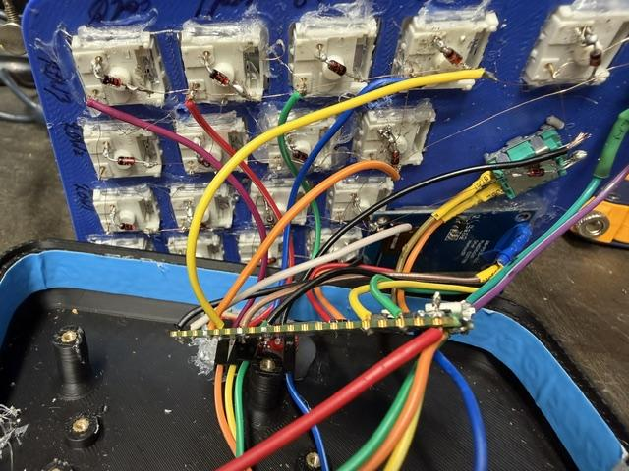
The Journey
Assembly
Involved soldering wires that were the size of human hairs
While installing the RGB strip, the glow insert I originally made didn’t fit so i filled the space where the glow insert was supposed to go with hot glue
The rotary encoders were secured to the face plate with 12mm washers and nuts
Screen, USB-C breakout, and Kalih Box Navy Mechanical Switches were secured in places with hot glue
Raspberry Pi Pico and faceplate are secured in place with 4 M2x12mm socket head bolts
Notes:
The hot glue actually worked better than the glow insert
Took almost 1.5 weeks to fully complete
Assembly was the most difficult part of this project

Slide 8
The Journey
Testing & Validation
Regularly had to reiterate and update code throughout because of errors with outdated library files or because of a bad microcontroller
Switched from a first gen Raspberry PI Pico to a second gen model due to conflicts with code compatibility and also because the first gen Pico turned out to be defective
Finally got code to work on version 42
Tested by first running led blink script to make sure the mcu (microcontroller unit) worked, then tested each component individually to make sure they all worked
After that, put everything together and made it work as a complete project

Slide 9
Thank You!
GitHuB Repo Link For My Code:

